Slide 1
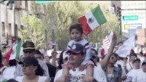
Hispanic American Contributions to American Culture

